Slide 1
GRADE 7 ACCELERATED · UNIT 4
Solving Problems with Rational Numbers
Six lessons in teaching order · the next slide jumps to each one
Grade 7 Accelerated · Unit 4 — Solving Problems with Rational Numbers
1

Slide 2
Contents
4.01
Adding and Subtracting in Scientific Notation
slide 3
4.02–03
Multiplying and Dividing in Scientific Notation
slide 37
4.04
Real-World Problems and Significant Digits
slide 71
4.05
Evaluating Expressions with Radicals
slide 105
4.06
Order of Operations with Radicals
slide 139
4.07–08
Real-World Order of Operations
slide 173
Grade 7 Accelerated · Unit 4 — Solving Problems with Rational Numbers
2

Slide 3
GRADE 7 ACCELERATED · UNIT 4 · LESSON 1
Adding and Subtracting in Scientific Notation
MA.8.NSO.1.5
I can add and subtract two numbers written in scientific notation, and write the answer in scientific notation.
Grade 7 Accelerated · Unit 4 · Lesson 1 — Adding and Subtracting in Scientific Notation
1

Slide 4


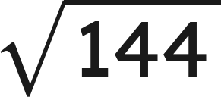

Warm-Up
1. Write 0.00062 in scientific notation.
2. How many times larger is
than
?
3. Find the value:
4. Find the sum:
Grade 7 Accelerated · Unit 4 · Lesson 1 — Adding and Subtracting in Scientific Notation
2

Slide 5
Warm-Up
1. Write 0.00062 in scientific notation.
6.2 × 10⁻⁴
2. How many times larger is
than
?
4,000
3. Find the value:
12
4. Find the sum:
1.69
Grade 7 Accelerated · Unit 4 · Lesson 1 — Adding and Subtracting in Scientific Notation
3

Slide 6
Notes
I. A power of ten is a place value
10³ | 10⁴ | 10⁵ | 10⁶
thousands | ten thousands | hundred thousands | millions
Two numbers can be added only when they carry the same power of ten.
Grade 7 Accelerated · Unit 4 · Lesson 1 — Adding and Subtracting in Scientific Notation
4

Slide 7
Notes
II. Same power: add or subtract the coefficients
Add or subtract the coefficients. The power of ten does not change.
Then check the coefficient: if it is not between 1 and 10, the answer is not finished.
Grade 7 Accelerated · Unit 4 · Lesson 1 — Adding and Subtracting in Scientific Notation
5

Slide 8
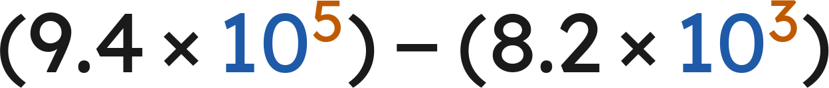

Notes
III. Different powers: rewrite one of them first
, never
Rewrite one number so both carry the same power of ten, then add or subtract the coefficients.
Exponent up one, decimal point one place left. The value does not move.
Grade 7 Accelerated · Unit 4 · Lesson 1 — Adding and Subtracting in Scientific Notation
6

Slide 9
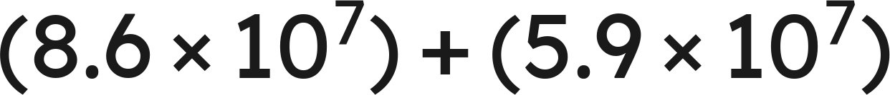
Example 1
Add. Write the answer in scientific notation.
Grade 7 Accelerated · Unit 4 · Lesson 1 — Adding and Subtracting in Scientific Notation
7

Slide 10

Example 1
Answer: 1.45 × 10⁸
Grade 7 Accelerated · Unit 4 · Lesson 1 — Adding and Subtracting in Scientific Notation
8

Slide 11
Your Turn
Add. Write the answer in scientific notation.
Grade 7 Accelerated · Unit 4 · Lesson 1 — Adding and Subtracting in Scientific Notation
9

Slide 12

Your Turn
Add. Write the answer in scientific notation.
Same power, so add the fronts:
Answer: 1.23 × 10⁻²
Grade 7 Accelerated · Unit 4 · Lesson 1 — Adding and Subtracting in Scientific Notation
10

Slide 13
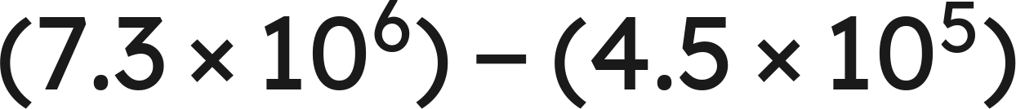
Example 2
Subtract. Write the answer in scientific notation.
Grade 7 Accelerated · Unit 4 · Lesson 1 — Adding and Subtracting in Scientific Notation
11

Slide 14
Example 2
Answer: 6.85 × 10⁶
Grade 7 Accelerated · Unit 4 · Lesson 1 — Adding and Subtracting in Scientific Notation
12

Slide 15
Your Turn
Subtract. Write the answer in scientific notation.
Grade 7 Accelerated · Unit 4 · Lesson 1 — Adding and Subtracting in Scientific Notation
13

Slide 16


Your Turn
Subtract. Write the answer in scientific notation.
Match the powers:
Answer: 5.51 × 10⁻⁴
Grade 7 Accelerated · Unit 4 · Lesson 1 — Adding and Subtracting in Scientific Notation
14

Slide 17
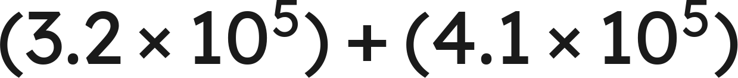
Whiteboards · Question 1 of 9
Answer it.
Grade 7 Accelerated · Unit 4 · Lesson 1 — Adding and Subtracting in Scientific Notation
15

Slide 18



Whiteboards · Question 1 of 9
Same power, so add the fronts:
Answer: 7.3 × 10⁵
Grade 7 Accelerated · Unit 4 · Lesson 1 — Adding and Subtracting in Scientific Notation
16

Slide 19


Whiteboards · Question 2 of 9
A stadium sold
tickets on Friday
and
on Saturday. Each ticket cost 38 dollars.
How many tickets were sold on the two days?
Answer it.
Grade 7 Accelerated · Unit 4 · Lesson 1 — Adding and Subtracting in Scientific Notation
17

Slide 20




Whiteboards · Question 2 of 9
A stadium sold
tickets on Friday
and
on Saturday. Each ticket cost 38 dollars.
How many tickets were sold on the two days?
Same power, so add the fronts:
Answer: 7.7 × 10⁴
Grade 7 Accelerated · Unit 4 · Lesson 1 — Adding and Subtracting in Scientific Notation
18

Slide 21
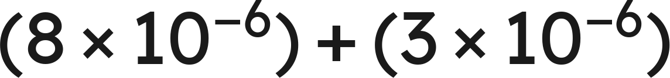
Whiteboards · Question 3 of 9
Answer it.
Grade 7 Accelerated · Unit 4 · Lesson 1 — Adding and Subtracting in Scientific Notation
19

Slide 22
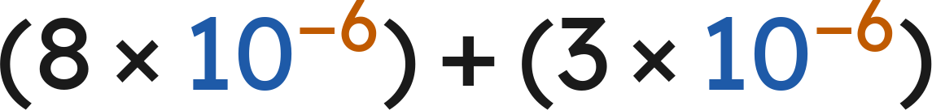

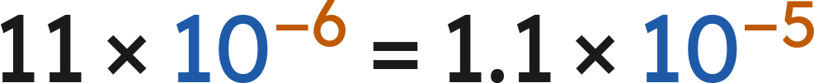
Whiteboards · Question 3 of 9
Answer: 1.1 × 10⁻⁵
Grade 7 Accelerated · Unit 4 · Lesson 1 — Adding and Subtracting in Scientific Notation
20

Slide 23
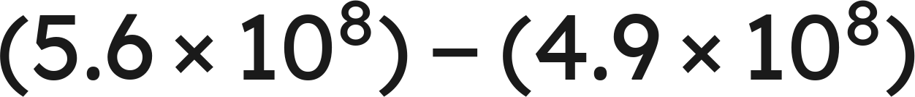
Whiteboards · Question 4 of 9
Answer it.
Grade 7 Accelerated · Unit 4 · Lesson 1 — Adding and Subtracting in Scientific Notation
21

Slide 24
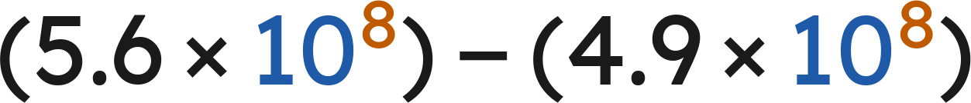


Whiteboards · Question 4 of 9
Answer: 7 × 10⁷
Grade 7 Accelerated · Unit 4 · Lesson 1 — Adding and Subtracting in Scientific Notation
22

Slide 25

Whiteboards · Question 5 of 9
Which is the sum?
A. 3.9 × 10⁶
B. 3.9 × 10¹⁰
C. 2.316 × 10⁶
D. 2.46 × 10⁶
Answer it.
Grade 7 Accelerated · Unit 4 · Lesson 1 — Adding and Subtracting in Scientific Notation
23

Slide 26


Whiteboards · Question 5 of 9
Which is the sum?
Match the powers:
Answer: C — 2.316 × 10⁶
Grade 7 Accelerated · Unit 4 · Lesson 1 — Adding and Subtracting in Scientific Notation
24

Slide 27

Whiteboards · Question 6 of 9
Which is the sum, written in scientific notation?
A. 12.3 × 10⁶
B. 12.3 × 10¹²
C. 1.23 × 10⁶
D. 1.23 × 10⁷
Answer it.
Grade 7 Accelerated · Unit 4 · Lesson 1 — Adding and Subtracting in Scientific Notation
25

Slide 28


Whiteboards · Question 6 of 9
Which is the sum, written in scientific notation?
Answer: D — 1.23 × 10⁷
Grade 7 Accelerated · Unit 4 · Lesson 1 — Adding and Subtracting in Scientific Notation
26

Slide 29
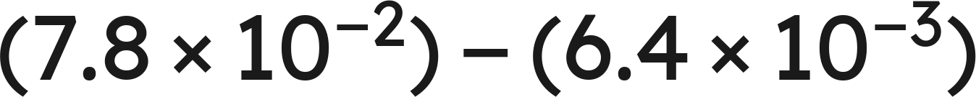
Whiteboards · Question 7 of 9
Answer it.
Grade 7 Accelerated · Unit 4 · Lesson 1 — Adding and Subtracting in Scientific Notation
27

Slide 30
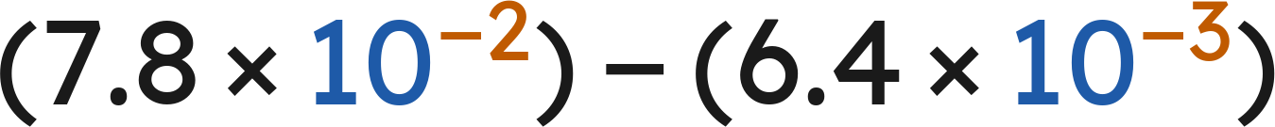


Whiteboards · Question 7 of 9
Match the powers:
Answer: 7.16 × 10⁻²
Grade 7 Accelerated · Unit 4 · Lesson 1 — Adding and Subtracting in Scientific Notation
28

Slide 31

Whiteboards · Question 8 of 9
What is the value of
?
Answer it.
Grade 7 Accelerated · Unit 4 · Lesson 1 — Adding and Subtracting in Scientific Notation
29

Slide 32

Whiteboards · Question 8 of 9
What is the value of
?
Answer: n = 5.7
Grade 7 Accelerated · Unit 4 · Lesson 1 — Adding and Subtracting in Scientific Notation
30

Slide 33
Whiteboards · Question 9 of 9
Devon writes
.
Name the two mistakes he made, and give the correct sum.
Write your answer in sentences.
Grade 7 Accelerated · Unit 4 · Lesson 1 — Adding and Subtracting in Scientific Notation
31

Slide 34

Whiteboards · Question 9 of 9
Devon writes
.
Name the two mistakes he made, and give the correct sum.
The powers do not match, and exponents are not added.
, so
Answer: 6.619 × 10⁴
Grade 7 Accelerated · Unit 4 · Lesson 1 — Adding and Subtracting in Scientific Notation
32

Slide 35
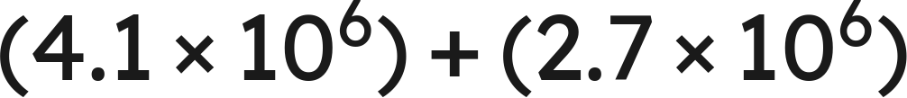
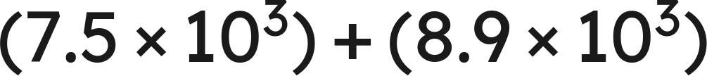
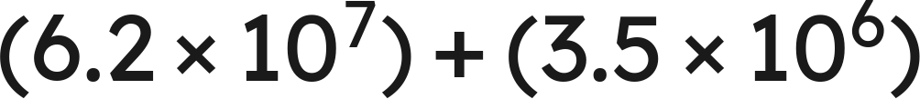

Independent Set
1.
2.
3.
4.
5.
6.
Find
.
Grade 7 Accelerated · Unit 4 · Lesson 1 — Adding and Subtracting in Scientific Notation
33

Slide 36
IXL
1.
Open IXL and start today's skills.
2.
Work on paper where the question needs work. The answer box does not show it.
3.
Every skill listed is required, to a SmartScore of 67. Due at the start of the next class.
Today's skills — all required
Add and subtract numbers written in scientific notation — HUR
Grade 7 Accelerated · Unit 4 · Lesson 1 — Adding and Subtracting in Scientific Notation
34

Slide 37
GRADE 7 ACCELERATED · UNIT 4 · LESSONS 2–3
Multiplying and Dividing in Scientific Notation
MA.8.NSO.1.5
I can multiply and divide two numbers written in scientific notation, and write the answer in scientific notation.
Grade 7 Accelerated · Unit 4 · Lessons 2–3 — Multiplying and Dividing in Scientific Notation
1

Slide 38

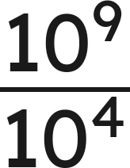
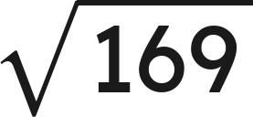
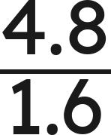
Warm-Up
1.
2. Write as one power:
3. Find the value:
4. Find the quotient:
Grade 7 Accelerated · Unit 4 · Lessons 2–3 — Multiplying and Dividing in Scientific Notation
2

Slide 39
Warm-Up
1.
6.2 × 10⁶
2. Write as one power:
10⁵
3. Find the value:
13
4. Find the quotient:
3
Grade 7 Accelerated · Unit 4 · Lessons 2–3 — Multiplying and Dividing in Scientific Notation
3

Slide 40


Notes
I. Multiplying: regroup, then use the laws
, never
Multiply the coefficients. Add the exponents — that is the product of powers law, not a new rule.
Grade 7 Accelerated · Unit 4 · Lessons 2–3 — Multiplying and Dividing in Scientific Notation
4

Slide 41
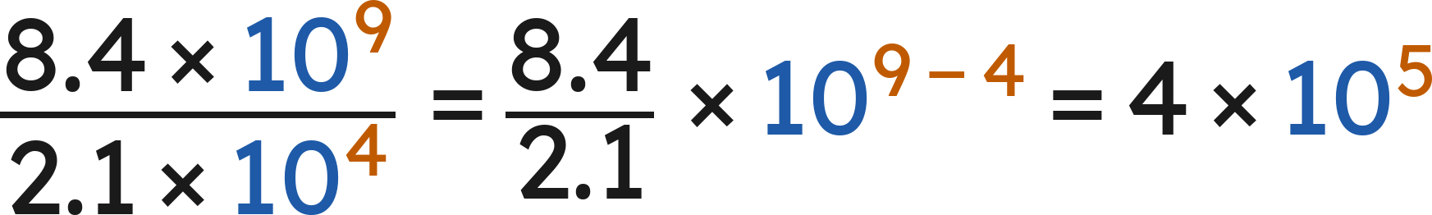
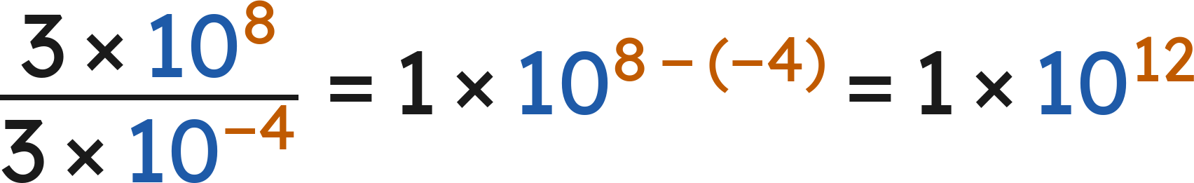
Notes
II. Dividing: the same move with the quotient law
Divide the coefficients. Subtract the exponents, top minus bottom.
Grade 7 Accelerated · Unit 4 · Lessons 2–3 — Multiplying and Dividing in Scientific Notation
5

Slide 42
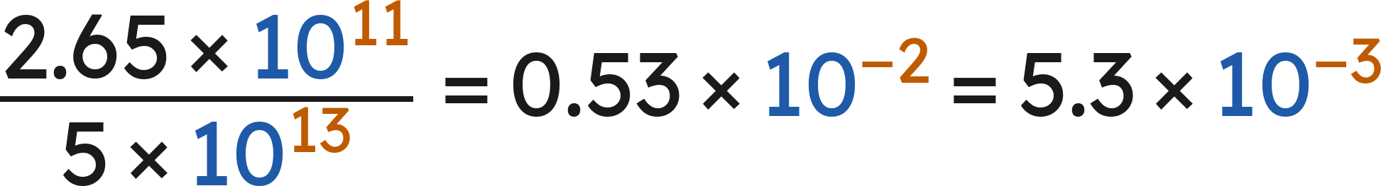
Notes
III. Finish the answer — both directions
Every answer ends with a coefficient at least 1 and less than 10.
Grade 7 Accelerated · Unit 4 · Lessons 2–3 — Multiplying and Dividing in Scientific Notation
6

Slide 43
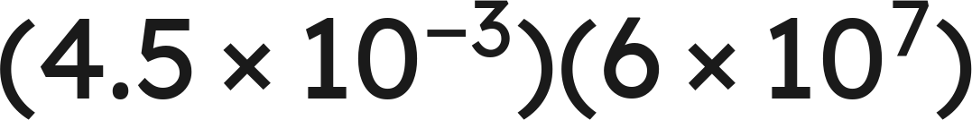
Example 1
Multiply. Write the answer in scientific notation.
Grade 7 Accelerated · Unit 4 · Lessons 2–3 — Multiplying and Dividing in Scientific Notation
7

Slide 44


Example 1
Answer: 2.7 × 10⁵
Grade 7 Accelerated · Unit 4 · Lessons 2–3 — Multiplying and Dividing in Scientific Notation
8

Slide 45
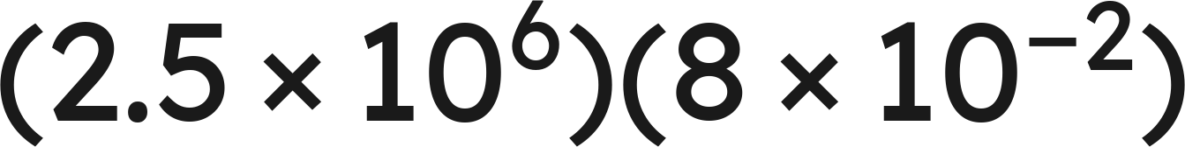
Your Turn
Multiply. Write the answer in scientific notation.
Grade 7 Accelerated · Unit 4 · Lessons 2–3 — Multiplying and Dividing in Scientific Notation
9

Slide 46
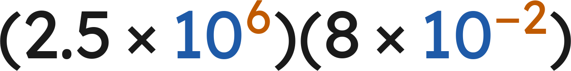



Your Turn
Multiply. Write the answer in scientific notation.
Multiply the fronts:
Add the exponents:
Answer: 2 × 10⁵
Grade 7 Accelerated · Unit 4 · Lessons 2–3 — Multiplying and Dividing in Scientific Notation
10

Slide 47
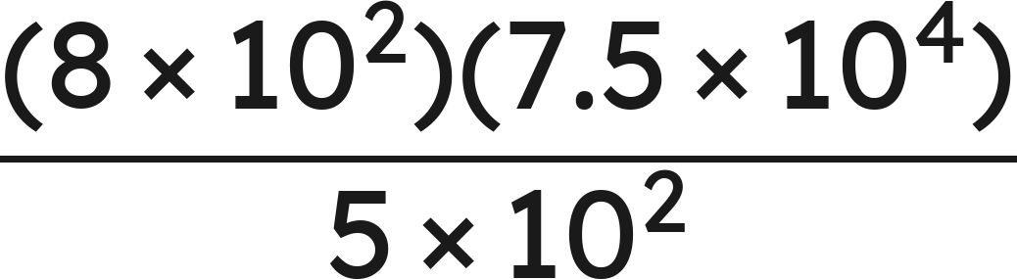
Example 2
Evaluate. Write the answer in scientific notation.
Grade 7 Accelerated · Unit 4 · Lessons 2–3 — Multiplying and Dividing in Scientific Notation
11

Slide 48
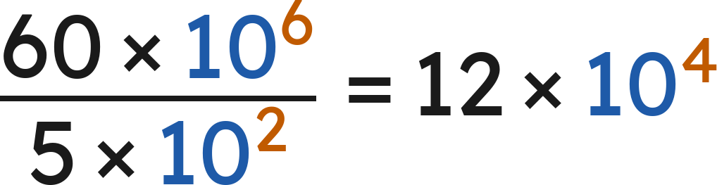

Example 2
Answer: 1.2 × 10⁵
Grade 7 Accelerated · Unit 4 · Lessons 2–3 — Multiplying and Dividing in Scientific Notation
12

Slide 49
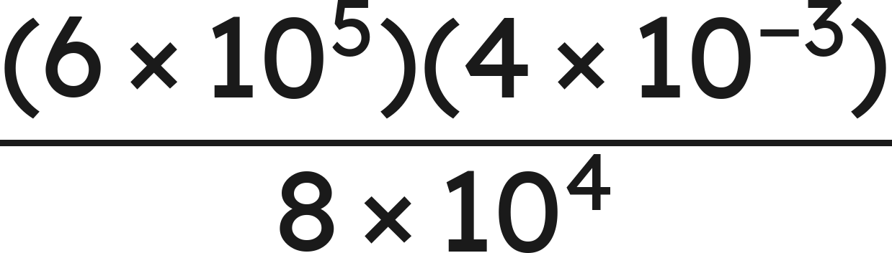
Your Turn
Evaluate. Write the answer in scientific notation.
Grade 7 Accelerated · Unit 4 · Lessons 2–3 — Multiplying and Dividing in Scientific Notation
13

Slide 50
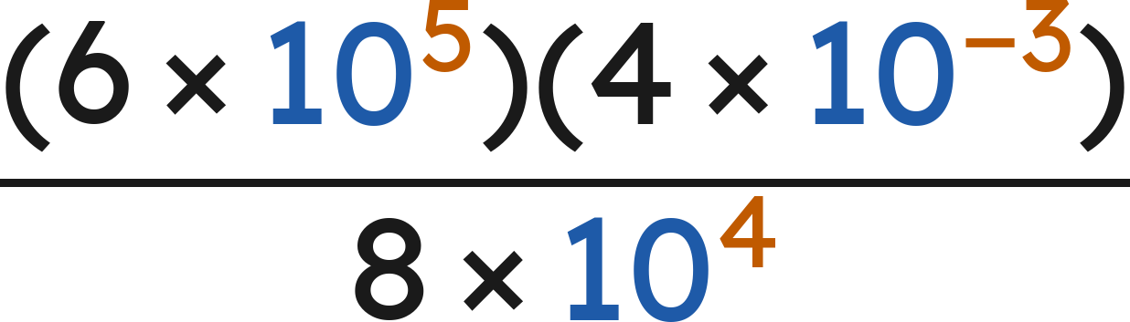





Your Turn
Evaluate. Write the answer in scientific notation.
Top:
and
Divide:
and
Answer: 3 × 10⁻²
Grade 7 Accelerated · Unit 4 · Lessons 2–3 — Multiplying and Dividing in Scientific Notation
14

Slide 51

Whiteboards · Question 1 of 9
Answer it.
Grade 7 Accelerated · Unit 4 · Lessons 2–3 — Multiplying and Dividing in Scientific Notation
15

Slide 52




Whiteboards · Question 1 of 9
Multiply the fronts:
Add the exponents:
Answer: 9 × 10¹¹
Grade 7 Accelerated · Unit 4 · Lessons 2–3 — Multiplying and Dividing in Scientific Notation
16

Slide 53


Whiteboards · Question 2 of 9
A printer makes
copies per hour.
It runs for
hours. Paper costs 3 cents a sheet.
How many copies does it make?
Answer it.
Grade 7 Accelerated · Unit 4 · Lessons 2–3 — Multiplying and Dividing in Scientific Notation
17

Slide 54





Whiteboards · Question 2 of 9
A printer makes
copies per hour.
It runs for
hours. Paper costs 3 cents a sheet.
How many copies does it make?
Multiply the fronts:
Add the exponents:
Answer: 1 × 10⁶
Grade 7 Accelerated · Unit 4 · Lessons 2–3 — Multiplying and Dividing in Scientific Notation
18

Slide 55
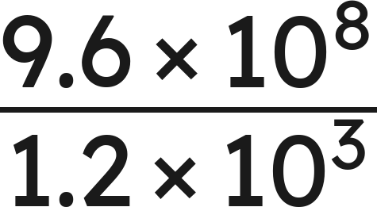
Whiteboards · Question 3 of 9
Answer it.
Grade 7 Accelerated · Unit 4 · Lessons 2–3 — Multiplying and Dividing in Scientific Notation
19

Slide 56
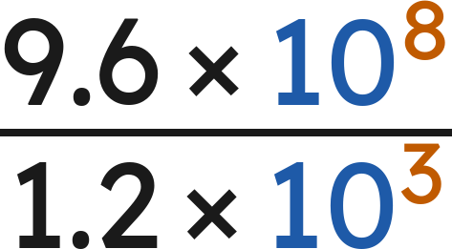



Whiteboards · Question 3 of 9
Divide the fronts:
Subtract the exponents:
Answer: 8 × 10⁵
Grade 7 Accelerated · Unit 4 · Lessons 2–3 — Multiplying and Dividing in Scientific Notation
20

Slide 57
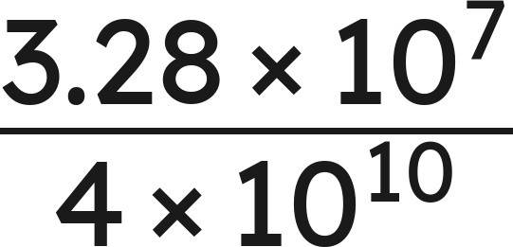
Whiteboards · Question 4 of 9
Answer it.
Grade 7 Accelerated · Unit 4 · Lessons 2–3 — Multiplying and Dividing in Scientific Notation
21

Slide 58
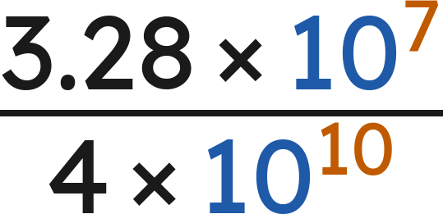


Whiteboards · Question 4 of 9
Divide the fronts:
Subtract the exponents:
Answer: 8.2 × 10⁻⁴
Grade 7 Accelerated · Unit 4 · Lessons 2–3 — Multiplying and Dividing in Scientific Notation
22

Slide 59
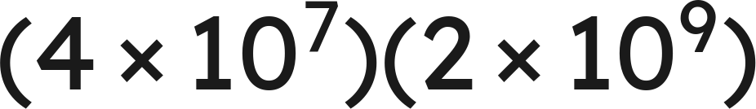
Whiteboards · Question 5 of 9
Which is the product?
A. 8 × 10⁻²
B. 8 × 10⁶³
C. 8 × 10¹⁶
D. 6 × 10¹⁶
Answer it.
Grade 7 Accelerated · Unit 4 · Lessons 2–3 — Multiplying and Dividing in Scientific Notation
23

Slide 60




Whiteboards · Question 5 of 9
Which is the product?
Multiply the fronts:
Add the exponents:
Answer: C — 8 × 10¹⁶
Grade 7 Accelerated · Unit 4 · Lessons 2–3 — Multiplying and Dividing in Scientific Notation
24

Slide 61
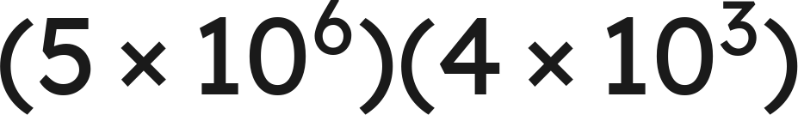
Whiteboards · Question 6 of 9
Which is the product, written in scientific notation?
A. 2 × 10⁹
B. 20 × 10⁹
C. 20 × 10¹⁸
D. 2 × 10¹⁰
Answer it.
Grade 7 Accelerated · Unit 4 · Lessons 2–3 — Multiplying and Dividing in Scientific Notation
25

Slide 62




Whiteboards · Question 6 of 9
Which is the product, written in scientific notation?
Multiply the fronts:
Add the exponents:
Answer: D — 2 × 10¹⁰
Grade 7 Accelerated · Unit 4 · Lessons 2–3 — Multiplying and Dividing in Scientific Notation
26

Slide 63
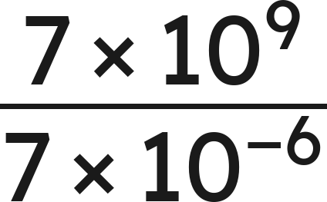
Whiteboards · Question 7 of 9
Answer it.
Grade 7 Accelerated · Unit 4 · Lessons 2–3 — Multiplying and Dividing in Scientific Notation
27

Slide 64
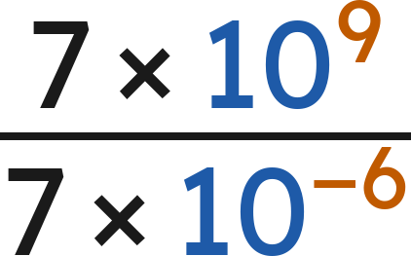


Whiteboards · Question 7 of 9
Divide the fronts:
Subtract the exponents:
Answer: 1 × 10¹⁵
Grade 7 Accelerated · Unit 4 · Lessons 2–3 — Multiplying and Dividing in Scientific Notation
28

Slide 65
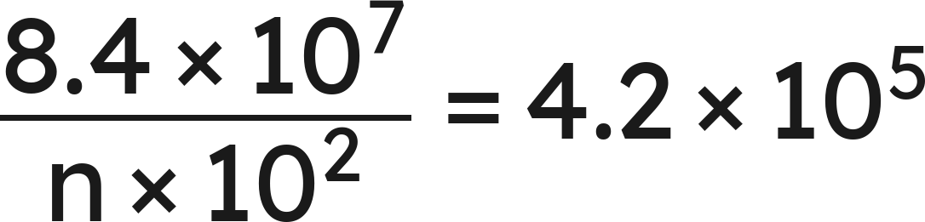
Whiteboards · Question 8 of 9
What is the value of
?
Answer it.
Grade 7 Accelerated · Unit 4 · Lessons 2–3 — Multiplying and Dividing in Scientific Notation
29

Slide 66
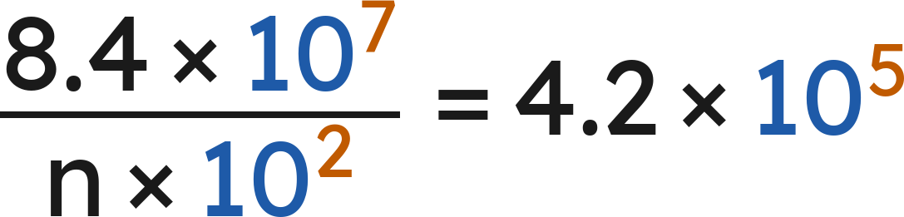


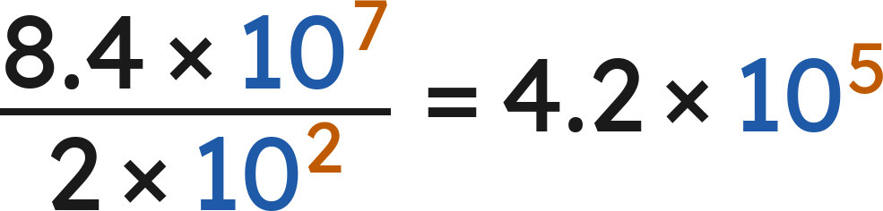
Whiteboards · Question 8 of 9
What is the value of
?
Fronts:
, so
Check:
Answer: n = 2
Grade 7 Accelerated · Unit 4 · Lessons 2–3 — Multiplying and Dividing in Scientific Notation
30

Slide 67
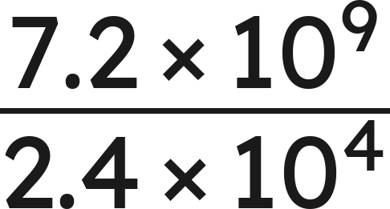

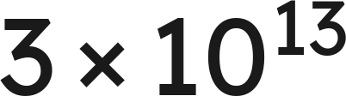
Whiteboards · Question 9 of 9
For
Marcus writes
and Sara writes
Name what each one did wrong, and give the correct quotient.
Write your answer in sentences.
Grade 7 Accelerated · Unit 4 · Lessons 2–3 — Multiplying and Dividing in Scientific Notation
31

Slide 68
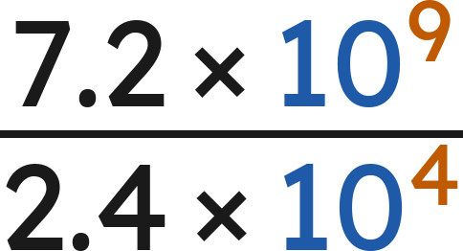

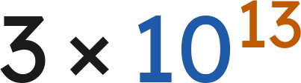



Whiteboards · Question 9 of 9
For
Marcus writes
and Sara writes
Name what each one did wrong, and give the correct quotient.
Marcus subtracted the fronts. Sara added the exponents.
and
Answer: 3 × 10⁵
Grade 7 Accelerated · Unit 4 · Lessons 2–3 — Multiplying and Dividing in Scientific Notation
32

Slide 69
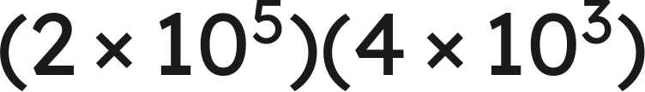
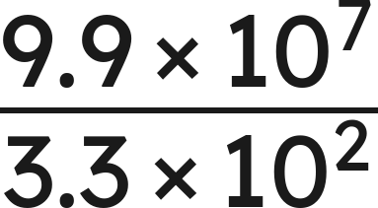
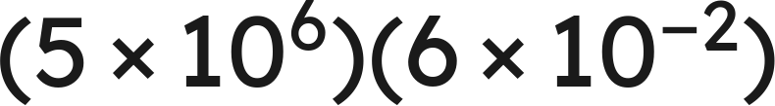
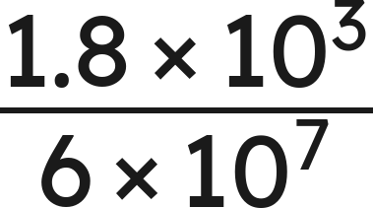
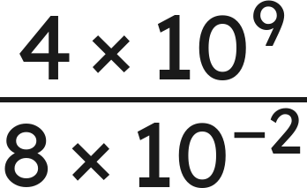
Independent Set
1.
2.
3.
4.
5.
6.
Find
.
Grade 7 Accelerated · Unit 4 · Lessons 2–3 — Multiplying and Dividing in Scientific Notation
33

Slide 70
IXL
1.
Open IXL and start today's skills.
2.
Work on paper where the question needs work. The answer box does not show it.
3.
Every skill listed is required, to a SmartScore of 67. Due at the start of the next class.
Today's skills — all required
Multiply numbers written in scientific notation — YZU
Divide numbers written in scientific notation — SGT
Grade 7 Accelerated · Unit 4 · Lessons 2–3 — Multiplying and Dividing in Scientific Notation
34

Slide 71
GRADE 7 ACCELERATED · UNIT 4 · LESSON 4
Real-World Problems and Significant Digits
MA.8.NSO.1.6
I can solve a real-world problem with numbers in scientific notation and report the answer with the right number of significant digits.
Grade 7 Accelerated · Unit 4 · Lesson 4 — Real-World Problems and Significant Digits
1

Slide 72
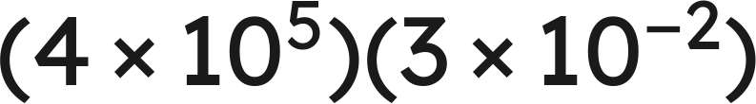
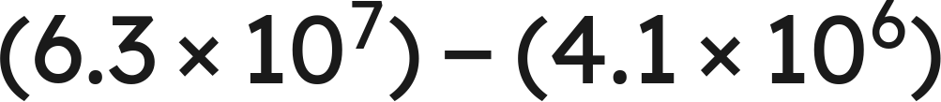
Warm-Up
1.
2.
3. Write 0.00902 in scientific notation.
4. Round 4.738 to the nearest hundredth.
Grade 7 Accelerated · Unit 4 · Lesson 4 — Real-World Problems and Significant Digits
2

Slide 73
Warm-Up
1.
1.2 × 10⁴
2.
5.89 × 10⁷
3. Write 0.00902 in scientific notation.
9.02 × 10⁻³
4. Round 4.738 to the nearest hundredth.
4.74
Grade 7 Accelerated · Unit 4 · Lesson 4 — Real-World Problems and Significant Digits
3

Slide 74
Notes
I. Which digits are significant
Measurement | Digits | Why
4,207 | 4 | the middle zero counts
0.0058 | 2 | leading zeros never count
3.200 | 4 | trailing zeros count after a decimal point
52,000 | 2 | no decimal point, so they do not
Grade 7 Accelerated · Unit 4 · Lesson 4 — Real-World Problems and Significant Digits
4

Slide 75

Notes
II. Multiplying or dividing: count the digits
2 significant digits and 3, so the answer keeps 2:
Multiply or divide: the answer takes the smaller of the two significant-digit counts.
Grade 7 Accelerated · Unit 4 · Lesson 4 — Real-World Problems and Significant Digits
5

Slide 76


Notes
III. Adding or subtracting: a different rule
1,234 stops at the ones place; 5.6 stops at the tenths
so the sum stops at the ones place:
Add or subtract: the answer stops at the leftmost of the two last-digit places.
Grade 7 Accelerated · Unit 4 · Lesson 4 — Real-World Problems and Significant Digits
6

Slide 77


Example 1
A solar array measures
m by
m.
What is its area?
Give the answer to the correct number of significant digits.
Grade 7 Accelerated · Unit 4 · Lesson 4 — Real-World Problems and Significant Digits
7

Slide 78
Example 1
Answer: 1.1 × 10⁴ square meters
Grade 7 Accelerated · Unit 4 · Lesson 4 — Real-World Problems and Significant Digits
8

Slide 79


Your Turn
A field measures
m by
m.
What is its area?
Grade 7 Accelerated · Unit 4 · Lesson 4 — Real-World Problems and Significant Digits
9

Slide 80





Your Turn
A field measures
m by
m.
What is its area?
and
Keep 2 significant digits (4.6 has 2):
Answer: 1.1 × 10⁵ square meters
Grade 7 Accelerated · Unit 4 · Lesson 4 — Real-World Problems and Significant Digits
10

Slide 81


Example 2
A container holds
cubic feet of liquid.
cubic feet evaporates.
How much is left? Give the answer with the correct precision.
Grade 7 Accelerated · Unit 4 · Lesson 4 — Real-World Problems and Significant Digits
11

Slide 82

Example 2
Answer: 3.06 × 10⁻³ cubic feet
Grade 7 Accelerated · Unit 4 · Lesson 4 — Real-World Problems and Significant Digits
12

Slide 83


Your Turn
A road is
m long.
A section
m long is repaved.
How much of the road is not repaved?
Grade 7 Accelerated · Unit 4 · Lesson 4 — Real-World Problems and Significant Digits
13

Slide 84




Your Turn
A road is
m long.
A section
m long is repaved.
How much of the road is not repaved?
3,850 stops at the tens place, so round to tens: 3,580
Answer: 3.58 × 10³ m
Grade 7 Accelerated · Unit 4 · Lesson 4 — Real-World Problems and Significant Digits
14

Slide 85
Whiteboards · Question 1 of 9
How many significant digits are in 0.00470 ?
Answer it.
Grade 7 Accelerated · Unit 4 · Lesson 4 — Real-World Problems and Significant Digits
15

Slide 86
Whiteboards · Question 1 of 9
How many significant digits are in 0.00470 ?
Leading zeros do not count: 0.00
4, 7 and the final 0 count: 3 significant digits
Answer: 3
Grade 7 Accelerated · Unit 4 · Lesson 4 — Real-World Problems and Significant Digits
16

Slide 87


Whiteboards · Question 2 of 9
A pond's surface measures
m by
m.
The pond is 3 meters deep.
Find the surface area. Round to the correct number of significant digits.
Answer it.
Grade 7 Accelerated · Unit 4 · Lesson 4 — Real-World Problems and Significant Digits
17

Slide 88






Whiteboards · Question 2 of 9
A pond's surface measures
m by
m.
The pond is 3 meters deep.
Find the surface area. Round to the correct number of significant digits.
and
Keep 2 significant digits:
Answer: 1.2 × 10⁴ square meters
Grade 7 Accelerated · Unit 4 · Lesson 4 — Real-World Problems and Significant Digits
18

Slide 89

Whiteboards · Question 3 of 9
Two measurements are multiplied. One has 3 significant digits
and the other has 5. The exact product is
.
How should the answer be written?
Answer it.
Grade 7 Accelerated · Unit 4 · Lesson 4 — Real-World Problems and Significant Digits
19

Slide 90



Whiteboards · Question 3 of 9
Two measurements are multiplied. One has 3 significant digits
and the other has 5. The exact product is
.
How should the answer be written?
The answer keeps the smaller count: 3 significant digits.
becomes
Answer: 7.41 × 10⁵
Grade 7 Accelerated · Unit 4 · Lesson 4 — Real-World Problems and Significant Digits
20

Slide 91

Whiteboards · Question 4 of 9
meters, both measured.
Write the sum with the correct precision.
Answer it.
Grade 7 Accelerated · Unit 4 · Lesson 4 — Real-World Problems and Significant Digits
21

Slide 92



Whiteboards · Question 4 of 9
meters, both measured.
Write the sum with the correct precision.
2,500 stops at the hundreds place, so round to hundreds: 3,000
Answer: 3.0 × 10³ m
Grade 7 Accelerated · Unit 4 · Lesson 4 — Real-World Problems and Significant Digits
22

Slide 93
Whiteboards · Question 5 of 9
How many significant digits are in 0.03080 ?
A. 4
B. 2
C. 5
D. 3
Answer it.
Grade 7 Accelerated · Unit 4 · Lesson 4 — Real-World Problems and Significant Digits
23

Slide 94
Whiteboards · Question 5 of 9
How many significant digits are in 0.03080 ?
Leading zeros do not count: 0.0
3, 0, 8 and the final 0 count: 4 significant digits
Answer: A — 4
Grade 7 Accelerated · Unit 4 · Lesson 4 — Real-World Problems and Significant Digits
24

Slide 95


Whiteboards · Question 6 of 9
A rectangle measures
cm by
cm.
Which is the area, to the correct significant digits?
A. 26.1 × 10⁴ cm²
B. 2.6 × 10⁵ cm²
C. 2.6 × 10⁴ cm²
D. 2.61 × 10⁵ cm²
Answer it.
Grade 7 Accelerated · Unit 4 · Lesson 4 — Real-World Problems and Significant Digits
25

Slide 96





Whiteboards · Question 6 of 9
A rectangle measures
cm by
cm.
Which is the area, to the correct significant digits?
and
Keep 2 significant digits (6.0 has 2):
Answer: B — 2.6 × 10⁵ cm²
Grade 7 Accelerated · Unit 4 · Lesson 4 — Real-World Problems and Significant Digits
26

Slide 97

Whiteboards · Question 7 of 9
A car travels
km in 3.0 hours.
What is its average speed, to the right number of significant digits?
Answer it.
Grade 7 Accelerated · Unit 4 · Lesson 4 — Real-World Problems and Significant Digits
27

Slide 98



Whiteboards · Question 7 of 9
A car travels
km in 3.0 hours.
What is its average speed, to the right number of significant digits?
3.0 has 2 significant digits, so keep 2:
Answer: 1.4 × 10² km/h
Grade 7 Accelerated · Unit 4 · Lesson 4 — Real-World Problems and Significant Digits
28

Slide 99


Whiteboards · Question 8 of 9
A measured length times a measured width gives an area
of
m². The length measured
m.
What did the width measure, to two significant digits?
Answer it.
Grade 7 Accelerated · Unit 4 · Lesson 4 — Real-World Problems and Significant Digits
29

Slide 100




Whiteboards · Question 8 of 9
A measured length times a measured width gives an area
of
m². The length measured
m.
What did the width measure, to two significant digits?
Two significant digits:
Answer: 4.0 × 10¹ m
Grade 7 Accelerated · Unit 4 · Lesson 4 — Real-World Problems and Significant Digits
30

Slide 101


Whiteboards · Question 9 of 9
Ellis says: 9,145 has 4 significant digits and 4.8 has 2,
so the sum
must be written with 2:
.
Explain why he is wrong, and give the correct sum.
Write your answer in sentences.
Grade 7 Accelerated · Unit 4 · Lesson 4 — Real-World Problems and Significant Digits
31

Slide 102



Whiteboards · Question 9 of 9
Ellis says: 9,145 has 4 significant digits and 4.8 has 2,
so the sum
must be written with 2:
.
Explain why he is wrong, and give the correct sum.
Adding uses decimal places, not a count of digits.
9,145 stops at the ones place, so round to ones: 9,150
Answer: 9,150 = 9.150 × 10³
Grade 7 Accelerated · Unit 4 · Lesson 4 — Real-World Problems and Significant Digits
32

Slide 103




Independent Set
1.
How many significant digits are in 6,030 grams?
2.
How many significant digits are in 0.00710 meters?
3.
A rectangle measures
m by
m. Find its area, to the correct
number of significant digits.
4.
meters, both measured. Write the sum with the correct
precision.
5.
A car travels
km in 4.0 hours. Find its average speed, to the correct
number of significant digits.
6.
grams, both measured. Write the difference with the
correct precision.
Grade 7 Accelerated · Unit 4 · Lesson 4 — Real-World Problems and Significant Digits
33

Slide 104
IXL
1.
Open IXL and start today's skills.
2.
Work on paper where the question needs work. The answer box does not show it.
3.
Every skill listed is required, to a SmartScore of 67. Due at the start of the next class.
Today's skills — all required
Add, subtract, multiply, and divide numbers written in scientific notation: word problems — D5S
Grade 7 Accelerated · Unit 4 · Lesson 4 — Real-World Problems and Significant Digits
34

Slide 105
GRADE 7 ACCELERATED · UNIT 4 · LESSON 5
Evaluating Expressions with Radicals
MA.8.NSO.1.7
I can evaluate an expression that contains square roots, cube roots and integer exponents.
Grade 7 Accelerated · Unit 4 · Lesson 5 — Evaluating Expressions with Radicals
1

Slide 106



Warm-Up
1. How many significant digits are in 0.0250 ?
2.
3. Find the value:
4. Evaluate:
Grade 7 Accelerated · Unit 4 · Lesson 5 — Evaluating Expressions with Radicals
2

Slide 107
Warm-Up
1. How many significant digits are in 0.0250 ?
3
2.
6 × 10⁻³
3. Find the value:
14
4. Evaluate:
8
Grade 7 Accelerated · Unit 4 · Lesson 5 — Evaluating Expressions with Radicals
3

Slide 108



Notes
I. The radical bar is a grouping symbol
, never
Everything under the bar is evaluated before the root is taken.
Grade 7 Accelerated · Unit 4 · Lesson 5 — Evaluating Expressions with Radicals
4

Slide 109





Notes
II. Square roots and cube roots are not the same shape
An odd root keeps the sign of its radicand. A square root sign never gives a negative value.
Grade 7 Accelerated · Unit 4 · Lesson 5 — Evaluating Expressions with Radicals
5

Slide 110



Notes
III. Radicals alongside exponents
Finish each piece — the radical, the power — and only then put them together.
Grade 7 Accelerated · Unit 4 · Lesson 5 — Evaluating Expressions with Radicals
6

Slide 111

Example 1
Evaluate.
Grade 7 Accelerated · Unit 4 · Lesson 5 — Evaluating Expressions with Radicals
7

Slide 112


Example 1
Answer: 17/4
Grade 7 Accelerated · Unit 4 · Lesson 5 — Evaluating Expressions with Radicals
8

Slide 113

Your Turn
Evaluate.
Grade 7 Accelerated · Unit 4 · Lesson 5 — Evaluating Expressions with Radicals
9

Slide 114




Your Turn
Evaluate.
Answer: −17/9
Grade 7 Accelerated · Unit 4 · Lesson 5 — Evaluating Expressions with Radicals
10

Slide 115

Example 2
Evaluate.
Grade 7 Accelerated · Unit 4 · Lesson 5 — Evaluating Expressions with Radicals
11

Slide 116



Example 2
Answer: 0.2
Grade 7 Accelerated · Unit 4 · Lesson 5 — Evaluating Expressions with Radicals
12

Slide 117

Your Turn
Evaluate.
Grade 7 Accelerated · Unit 4 · Lesson 5 — Evaluating Expressions with Radicals
13

Slide 118



Your Turn
Evaluate.
Answer: 8
Grade 7 Accelerated · Unit 4 · Lesson 5 — Evaluating Expressions with Radicals
14

Slide 119

Whiteboards · Question 1 of 9
Answer it.
Grade 7 Accelerated · Unit 4 · Lesson 5 — Evaluating Expressions with Radicals
15

Slide 120



Whiteboards · Question 1 of 9
, so
Answer: 11
Grade 7 Accelerated · Unit 4 · Lesson 5 — Evaluating Expressions with Radicals
16

Slide 121
Whiteboards · Question 2 of 9
A square patio has an area of 169 square feet.
Fencing for it costs 12 dollars a foot.
How long is one side of the patio?
Answer it.
Grade 7 Accelerated · Unit 4 · Lesson 5 — Evaluating Expressions with Radicals
17

Slide 122


Whiteboards · Question 2 of 9
A square patio has an area of 169 square feet.
Fencing for it costs 12 dollars a foot.
How long is one side of the patio?
Side × side = 169
, so
Answer: 13 feet
Grade 7 Accelerated · Unit 4 · Lesson 5 — Evaluating Expressions with Radicals
18

Slide 123

Whiteboards · Question 3 of 9
Answer it.
Grade 7 Accelerated · Unit 4 · Lesson 5 — Evaluating Expressions with Radicals
19

Slide 124


Whiteboards · Question 3 of 9
, so
Answer: −5
Grade 7 Accelerated · Unit 4 · Lesson 5 — Evaluating Expressions with Radicals
20

Slide 125

Whiteboards · Question 4 of 9
Answer it.
Grade 7 Accelerated · Unit 4 · Lesson 5 — Evaluating Expressions with Radicals
21

Slide 126



Whiteboards · Question 4 of 9
Under the bar first:
Answer: 5
Grade 7 Accelerated · Unit 4 · Lesson 5 — Evaluating Expressions with Radicals
22

Slide 127

Whiteboards · Question 5 of 9
Which is the value?
A. 17
B. 169
C. 84.5
D. 13
Answer it.
Grade 7 Accelerated · Unit 4 · Lesson 5 — Evaluating Expressions with Radicals
23

Slide 128


Whiteboards · Question 5 of 9
Which is the value?
Under the bar first:
Answer: D — 13
Grade 7 Accelerated · Unit 4 · Lesson 5 — Evaluating Expressions with Radicals
24

Slide 129

Whiteboards · Question 6 of 9
Which is the value?
A. −1/4
B. not a real number
C. −1/8
D. 1/4
Answer it.
Grade 7 Accelerated · Unit 4 · Lesson 5 — Evaluating Expressions with Radicals
25

Slide 130



Whiteboards · Question 6 of 9
Which is the value?
so
Answer: A — −1/4
Grade 7 Accelerated · Unit 4 · Lesson 5 — Evaluating Expressions with Radicals
26

Slide 131

Whiteboards · Question 7 of 9
Answer it.
Grade 7 Accelerated · Unit 4 · Lesson 5 — Evaluating Expressions with Radicals
27

Slide 132




Whiteboards · Question 7 of 9
and
Answer: 4/3
Grade 7 Accelerated · Unit 4 · Lesson 5 — Evaluating Expressions with Radicals
28

Slide 133

Whiteboards · Question 8 of 9
Answer it.
Grade 7 Accelerated · Unit 4 · Lesson 5 — Evaluating Expressions with Radicals
29

Slide 134



Whiteboards · Question 8 of 9
Answer: 1/100
Grade 7 Accelerated · Unit 4 · Lesson 5 — Evaluating Expressions with Radicals
30

Slide 135

Whiteboards · Question 9 of 9
Simon says that
is not a real number,
because you cannot take the root of a negative.
Explain why he is wrong, and give the value.
Write your answer in sentences.
Grade 7 Accelerated · Unit 4 · Lesson 5 — Evaluating Expressions with Radicals
31

Slide 136


Whiteboards · Question 9 of 9
Simon says that
is not a real number,
because you cannot take the root of a negative.
Explain why he is wrong, and give the value.
A cube root can be negative: three negatives multiply to a negative.
, so
Answer: −3
Grade 7 Accelerated · Unit 4 · Lesson 5 — Evaluating Expressions with Radicals
32

Slide 137






Independent Set
1.
2.
3.
4.
5.
6.
Grade 7 Accelerated · Unit 4 · Lesson 5 — Evaluating Expressions with Radicals
33

Slide 138
IXL
1.
Open IXL and start today's skills.
2.
Work on paper where the question needs work. The answer box does not show it.
3.
Every skill listed is required, to a SmartScore of 67. This skill continues tomorrow: one assignment, due at the start of the class after 4.06.
Today's skills — all required
Evaluate radical expressions — D8J
Grade 7 Accelerated · Unit 4 · Lesson 5 — Evaluating Expressions with Radicals
34

Slide 139
GRADE 7 ACCELERATED · UNIT 4 · LESSON 6
Order of Operations with Radicals
MA.8.NSO.1.7
I can evaluate a multi-step expression with rational numbers, exponents and radicals by reading its structure.
Grade 7 Accelerated · Unit 4 · Lesson 6 — Order of Operations with Radicals
1

Slide 140



Warm-Up
1.
2. How many significant digits are in 1.020 ?
3. Find the value:
4. Evaluate:
Grade 7 Accelerated · Unit 4 · Lesson 6 — Order of Operations with Radicals
2

Slide 141
Warm-Up
1.
4
2. How many significant digits are in 1.020 ?
4
3. Find the value:
9/4
4. Evaluate:
8
Grade 7 Accelerated · Unit 4 · Lesson 6 — Order of Operations with Radicals
3

Slide 142
Notes
I. The structure, not a mnemonic
 | Level | What it means
1 | Grouping symbols | ( ), [ ], the radical bar, the fraction bar
2 | Powers and roots | the same level as each other
3 | Multiply and divide | left to right
4 | Add and subtract | left to right
Innermost grouping symbol first, then out.
Grade 7 Accelerated · Unit 4 · Lesson 6 — Order of Operations with Radicals
4

Slide 143


Notes
II. Left to right means left to right
, never
, never
Multiplication and division are one level. Addition and subtraction are one level. Left to right, both times.
Grade 7 Accelerated · Unit 4 · Lesson 6 — Order of Operations with Radicals
5

Slide 144


Notes
III. The fraction bar groups, top and bottom
Finish the numerator and finish the denominator before you divide.
Grade 7 Accelerated · Unit 4 · Lesson 6 — Order of Operations with Radicals
6

Slide 145

Example 1
Evaluate.
Grade 7 Accelerated · Unit 4 · Lesson 6 — Order of Operations with Radicals
7

Slide 146

Example 1
Answer: −1.44
Grade 7 Accelerated · Unit 4 · Lesson 6 — Order of Operations with Radicals
8

Slide 147

Your Turn
Evaluate.
Grade 7 Accelerated · Unit 4 · Lesson 6 — Order of Operations with Radicals
9

Slide 148




Your Turn
Evaluate.
Powers and roots:
and
Inside the parentheses:
Answer: 9.97
Grade 7 Accelerated · Unit 4 · Lesson 6 — Order of Operations with Radicals
10

Slide 149

Example 2
Evaluate.
Grade 7 Accelerated · Unit 4 · Lesson 6 — Order of Operations with Radicals
11

Slide 150



Example 2
Answer: −1/4
Grade 7 Accelerated · Unit 4 · Lesson 6 — Order of Operations with Radicals
12

Slide 151

Your Turn
Evaluate.
Grade 7 Accelerated · Unit 4 · Lesson 6 — Order of Operations with Radicals
13

Slide 152




Your Turn
Evaluate.
Answer: 1
Grade 7 Accelerated · Unit 4 · Lesson 6 — Order of Operations with Radicals
14

Slide 153

Whiteboards · Question 1 of 9
Answer it.
Grade 7 Accelerated · Unit 4 · Lesson 6 — Order of Operations with Radicals
15

Slide 154



Whiteboards · Question 1 of 9
Left to right:
Answer: 54
Grade 7 Accelerated · Unit 4 · Lesson 6 — Order of Operations with Radicals
16

Slide 155
Whiteboards · Question 2 of 9
A square tile has side
centimeters.
Its diagonal is about 19.8 centimeters.
What is the perimeter of the tile?
Answer it.
Grade 7 Accelerated · Unit 4 · Lesson 6 — Order of Operations with Radicals
17

Slide 156



Whiteboards · Question 2 of 9
A square tile has side
centimeters.
Its diagonal is about 19.8 centimeters.
What is the perimeter of the tile?
Perimeter:
Answer: 56 centimeters
Grade 7 Accelerated · Unit 4 · Lesson 6 — Order of Operations with Radicals
18

Slide 157

Whiteboards · Question 3 of 9
Answer it.
Grade 7 Accelerated · Unit 4 · Lesson 6 — Order of Operations with Radicals
19

Slide 158



Whiteboards · Question 3 of 9
Left to right:
Answer: 15
Grade 7 Accelerated · Unit 4 · Lesson 6 — Order of Operations with Radicals
20

Slide 159

Whiteboards · Question 4 of 9
Answer it.
Grade 7 Accelerated · Unit 4 · Lesson 6 — Order of Operations with Radicals
21

Slide 160



Whiteboards · Question 4 of 9
Top:
Bottom:
Answer: 3/5
Grade 7 Accelerated · Unit 4 · Lesson 6 — Order of Operations with Radicals
22

Slide 161

Whiteboards · Question 5 of 9
Which is the value?
A. 146
B. 50
C. 26
D. 80
Answer it.
Grade 7 Accelerated · Unit 4 · Lesson 6 — Order of Operations with Radicals
23

Slide 162




Whiteboards · Question 5 of 9
Which is the value?
Power first:
Then multiply:
Then add:
Answer: B — 50
Grade 7 Accelerated · Unit 4 · Lesson 6 — Order of Operations with Radicals
24

Slide 163

Whiteboards · Question 6 of 9
Which is the value?
A. 4
B. 35.5
C. 0.5
D. 256
Answer it.
Grade 7 Accelerated · Unit 4 · Lesson 6 — Order of Operations with Radicals
25

Slide 164




Whiteboards · Question 6 of 9
Which is the value?
Top:
Bottom:
Answer: A — 4
Grade 7 Accelerated · Unit 4 · Lesson 6 — Order of Operations with Radicals
26

Slide 165

Whiteboards · Question 7 of 9
Answer it.
Grade 7 Accelerated · Unit 4 · Lesson 6 — Order of Operations with Radicals
27

Slide 166




Whiteboards · Question 7 of 9
(the exponent is on the 2 only)
Answer: 0
Grade 7 Accelerated · Unit 4 · Lesson 6 — Order of Operations with Radicals
28

Slide 167

Whiteboards · Question 8 of 9
Answer it.
Grade 7 Accelerated · Unit 4 · Lesson 6 — Order of Operations with Radicals
29

Slide 168





Whiteboards · Question 8 of 9
and
Answer: 17/6
Grade 7 Accelerated · Unit 4 · Lesson 6 — Order of Operations with Radicals
30

Slide 169

Whiteboards · Question 9 of 9
Roscoe says that
is always positive,
because a square is always positive.
Is he right? Give a value of
that settles it.
Write your answer in sentences.
Grade 7 Accelerated · Unit 4 · Lesson 6 — Order of Operations with Radicals
31

Slide 170




Whiteboards · Question 9 of 9
Roscoe says that
is always positive,
because a square is always positive.
Is he right? Give a value of
that settles it.
When
:
, and 0 is not positive.
Answer: No — at n = 121 the value is 0
Grade 7 Accelerated · Unit 4 · Lesson 6 — Order of Operations with Radicals
32

Slide 171






Independent Set
1.
2.
3.
4.
5.
6.
Grade 7 Accelerated · Unit 4 · Lesson 6 — Order of Operations with Radicals
33

Slide 172
IXL
1.
Open IXL and start today's skills.
2.
Work on paper where the question needs work. The answer box does not show it.
3.
Every skill listed is required, to a SmartScore of 67. Due at the start of the next class.
Today's skills — all required
Evaluate radical expressions — D8J
Grade 7 Accelerated · Unit 4 · Lesson 6 — Order of Operations with Radicals
34

Slide 173
GRADE 7 ACCELERATED · UNIT 4 · LESSONS 7–8
Real-World Order of Operations
MA.8.NSO.1.7
I can substitute values into a formula and evaluate it, reading what the situation does rather than hunting for key words.
Grade 7 Accelerated · Unit 4 · Lessons 7–8 — Real-World Order of Operations
1

Slide 174





Warm-Up
1.
2.
3. Find the value:
4. Evaluate
when
.
Grade 7 Accelerated · Unit 4 · Lessons 7–8 — Real-World Order of Operations
2

Slide 175
Warm-Up
1.
0
2.
25/2
3. Find the value:
4/3
4. Evaluate
when
.
18
Grade 7 Accelerated · Unit 4 · Lessons 7–8 — Real-World Order of Operations
3

Slide 176







Notes
I. Substituting: the value goes in parentheses
with
and
:
joules
with
:
, never
Substitute in parentheses, then evaluate by the structure — powers before products.
Grade 7 Accelerated · Unit 4 · Lessons 7–8 — Real-World Order of Operations
4

Slide 177


Notes
II. Key words do not decide the operation
15 dollars plus 4 dollars for each of 6 gigabytes:
15 dollars for each of 4 lines, plus 6 dollars of tax:
The same words, the same numbers, different structures. Read the situation.
Grade 7 Accelerated · Unit 4 · Lessons 7–8 — Real-World Order of Operations
5

Slide 178


Notes
III. Round once, at the end — and say the unit
feet
rounding the side to 14 first:
feet
Carry the exact value, round once at the end, and write the unit.
Grade 7 Accelerated · Unit 4 · Lessons 7–8 — Real-World Order of Operations
6

Slide 179




Example 1
Kinetic energy is
,
for mass
in kilograms and speed
in meters per second.
Find
for a car of mass 1,200 kg travelling at 15 m/s.
Give the answer with its unit.
Grade 7 Accelerated · Unit 4 · Lessons 7–8 — Real-World Order of Operations
7

Slide 180


Example 1
Answer: 135,000 joules
Grade 7 Accelerated · Unit 4 · Lessons 7–8 — Real-World Order of Operations
8

Slide 181



Your Turn
Find
for
kg and
m/s.
Grade 7 Accelerated · Unit 4 · Lessons 7–8 — Real-World Order of Operations
9

Slide 182





Your Turn
Find
for
kg and
m/s.
Answer: 61,200 joules
Grade 7 Accelerated · Unit 4 · Lessons 7–8 — Real-World Order of Operations
10

Slide 183
Example 2
A square floor of side 9 feet is carpeted.
Carpet is 2.89 dollars a square foot and padding is 0.75 dollars a square foot.
Installation is a flat 95 dollars. Find the total cost.
Grade 7 Accelerated · Unit 4 · Lessons 7–8 — Real-World Order of Operations
11

Slide 184


Example 2
Answer: 389.84 dollars
Grade 7 Accelerated · Unit 4 · Lessons 7–8 — Real-World Order of Operations
12

Slide 185
Your Turn
A square bathroom floor of side 6 feet is tiled.
Tile is 4.25 dollars a square foot and grout is a flat 13.48 dollars.
Find the total cost.
Grade 7 Accelerated · Unit 4 · Lessons 7–8 — Real-World Order of Operations
13

Slide 186


Your Turn
A square bathroom floor of side 6 feet is tiled.
Tile is 4.25 dollars a square foot and grout is a flat 13.48 dollars.
Find the total cost.
Area:
Tile:
Total:
Answer: 166.48 dollars
Grade 7 Accelerated · Unit 4 · Lessons 7–8 — Real-World Order of Operations
14

Slide 187


Whiteboards · Question 1 of 9
Evaluate
when
.
Answer it.
Grade 7 Accelerated · Unit 4 · Lessons 7–8 — Real-World Order of Operations
15

Slide 188



Whiteboards · Question 1 of 9
Evaluate
when
.
Answer: 12
Grade 7 Accelerated · Unit 4 · Lessons 7–8 — Real-World Order of Operations
16

Slide 189



Whiteboards · Question 2 of 9
A cyclist has a mass of 70 kilograms and rides at 8 meters per second.
Her bicycle cost 480 dollars.
Kinetic energy is
, for a mass
and a speed
.
Find her kinetic energy.
Answer it.
Grade 7 Accelerated · Unit 4 · Lessons 7–8 — Real-World Order of Operations
17

Slide 190


Whiteboards · Question 2 of 9
A cyclist has a mass of 70 kilograms and rides at 8 meters per second.
Her bicycle cost 480 dollars.
Kinetic energy is
, for a mass
and a speed
.
Find her kinetic energy.
Answer: 2,240 joules
Grade 7 Accelerated · Unit 4 · Lessons 7–8 — Real-World Order of Operations
18

Slide 191
Whiteboards · Question 3 of 9
Renting a kayak costs 17 dollars plus 9 dollars for each hour.
Find the cost of 3 hours.
Answer it.
Grade 7 Accelerated · Unit 4 · Lessons 7–8 — Real-World Order of Operations
19

Slide 192


Whiteboards · Question 3 of 9
Renting a kayak costs 17 dollars plus 9 dollars for each hour.
Find the cost of 3 hours.
Answer: 44 dollars
Grade 7 Accelerated · Unit 4 · Lessons 7–8 — Real-World Order of Operations
20

Slide 193
Whiteboards · Question 4 of 9
A square floor of side 8 feet is tiled at 3.50 dollars a square foot.
Installation is a flat 60 dollars.
Find the total cost.
Answer it.
Grade 7 Accelerated · Unit 4 · Lessons 7–8 — Real-World Order of Operations
21

Slide 194



Whiteboards · Question 4 of 9
A square floor of side 8 feet is tiled at 3.50 dollars a square foot.
Installation is a flat 60 dollars.
Find the total cost.
Area:
Tile:
Total:
Answer: 284 dollars
Grade 7 Accelerated · Unit 4 · Lessons 7–8 — Real-World Order of Operations
22

Slide 195



Whiteboards · Question 5 of 9
Evaluate
when
and
.
Which is the value?
A. 180
B. 120
C. 360
D. 3,600
Answer it.
Grade 7 Accelerated · Unit 4 · Lessons 7–8 — Real-World Order of Operations
23

Slide 196




Whiteboards · Question 5 of 9
Evaluate
when
and
.
Which is the value?
Answer: A — 180
Grade 7 Accelerated · Unit 4 · Lessons 7–8 — Real-World Order of Operations
24

Slide 197
Whiteboards · Question 6 of 9
A square patio of side 12 feet is sealed at 1.25 dollars a square foot.
Delivery of the sealer is a flat 38 dollars.
Which expression gives the total cost?
A. 12(1.25) + 38
B. 12² + 1.25 + 38
C. 12²(1.25 + 38)
D. 12²(1.25) + 38
Answer it.
Grade 7 Accelerated · Unit 4 · Lessons 7–8 — Real-World Order of Operations
25

Slide 198



Whiteboards · Question 6 of 9
A square patio of side 12 feet is sealed at 1.25 dollars a square foot.
Delivery of the sealer is a flat 38 dollars.
Which expression gives the total cost?
Area
square feet, at 1.25 dollars each:
The 38 dollars is added once:
Answer: D — 12²(1.25) + 38
Grade 7 Accelerated · Unit 4 · Lessons 7–8 — Real-World Order of Operations
26

Slide 199

Whiteboards · Question 7 of 9
A square garden has 4 sides, each
feet long.
Find its perimeter, to the nearest hundredth of a foot.
Answer it.
Grade 7 Accelerated · Unit 4 · Lessons 7–8 — Real-World Order of Operations
27

Slide 200


Whiteboards · Question 7 of 9
A square garden has 4 sides, each
feet long.
Find its perimeter, to the nearest hundredth of a foot.
Answer: 48.99 feet
Grade 7 Accelerated · Unit 4 · Lessons 7–8 — Real-World Order of Operations
28

Slide 201




Whiteboards · Question 8 of 9
Evaluate
when
,
,
.
Answer it.
Grade 7 Accelerated · Unit 4 · Lessons 7–8 — Real-World Order of Operations
29

Slide 202





Whiteboards · Question 8 of 9
Evaluate
when
,
,
.
Top:
Answer: 9
Grade 7 Accelerated · Unit 4 · Lessons 7–8 — Real-World Order of Operations
30

Slide 203
Whiteboards · Question 9 of 9
One pizza order costs 13 dollars plus 2 dollars for each of 5 toppings.
Another costs 13 dollars for each of 2 pizzas, plus 5 dollars for delivery.
Find both totals, and say why the key words could not have told you.
Write your answer in sentences.
Grade 7 Accelerated · Unit 4 · Lessons 7–8 — Real-World Order of Operations
31

Slide 204
Whiteboards · Question 9 of 9
One pizza order costs 13 dollars plus 2 dollars for each of 5 toppings.
Another costs 13 dollars for each of 2 pizzas, plus 5 dollars for delivery.
Find both totals, and say why the key words could not have told you.
First order:
Second order:
Both say "plus" and "for each". What repeats is different.
Answer: 23 dollars and 31 dollars
Grade 7 Accelerated · Unit 4 · Lessons 7–8 — Real-World Order of Operations
32

Slide 205












Independent Set
1.
when
2.
when
and
3.
when
,
,
4.
A square room of side 10 feet is carpeted at 2.65 dollars a square
foot, with a flat 55 dollars for fitting. Find the total cost.
5.
when
and
6.
A gym charges 25 dollars to join plus 8 dollars for each of 6 classes.
Find the total cost.
Grade 7 Accelerated · Unit 4 · Lessons 7–8 — Real-World Order of Operations
33

Slide 206
IXL
1.
Open IXL and start today's skills.
2.
Work on paper where the question needs work. The answer box does not show it.
3.
Every skill listed is required, to a SmartScore of 67. Due at the start of the next class.
Today's skills — all required
Evaluate variable expressions: word problems — DPG
Grade 7 Accelerated · Unit 4 · Lessons 7–8 — Real-World Order of Operations
34

